Slide 1
Summer vaction Project Bustub: Database Internal CMU 15-445/646
Github : sg20180546
20180546변성진

Slide 2
Outline
Database Internal
Project 1 : Buffer Pool Manager
Project 2 : Extendible Hash Table
Project 3 : Query Execution
Project 4 : Transaction/ Lock
<number>

Slide 3
CMU Intro to DB System
CMU 15-445
https://15445.courses.cs.cmu.edu/fall2021/assignments.html
https://youtu.be/v4bU6n97Vr8
<number>

Slide 4
Recommend to ...
Seeking and interest in Database Internal, But It is HARD to BUILD YOUR DB without ANY FRAMEWORK.
Struggle to high learning curve of Open Source Project
Used To C, But get difficulty in LOTS OF C++ Standard Library
<number>

Slide 5
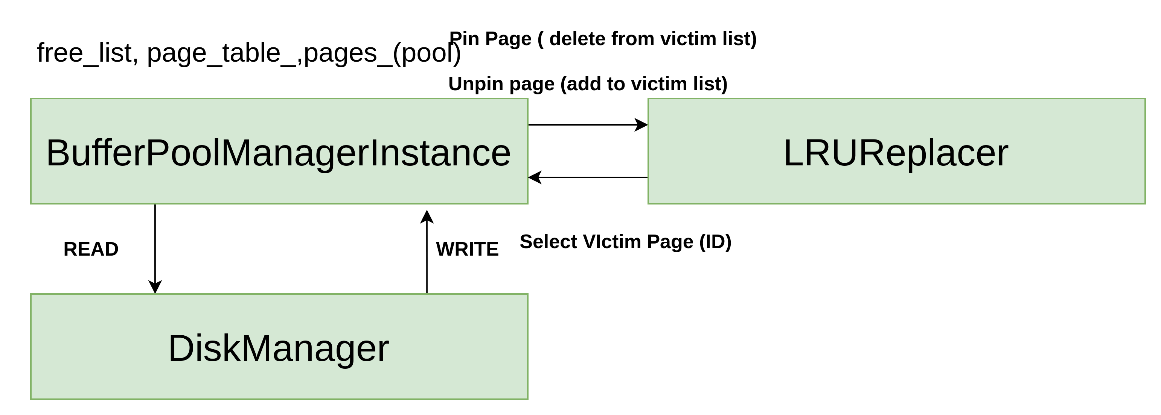
Buffer Pool Manager
LRU replacer
Disk Manager
Virtual Page impl
<number>

Slide 6
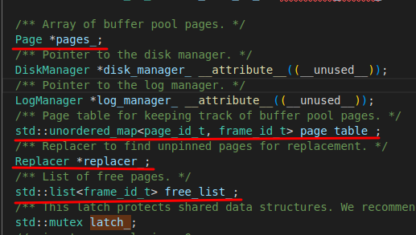
1.Buffer Pool Manager
FetchPage
NewPage
DeletePage
FlushPage
<number>

Slide 7
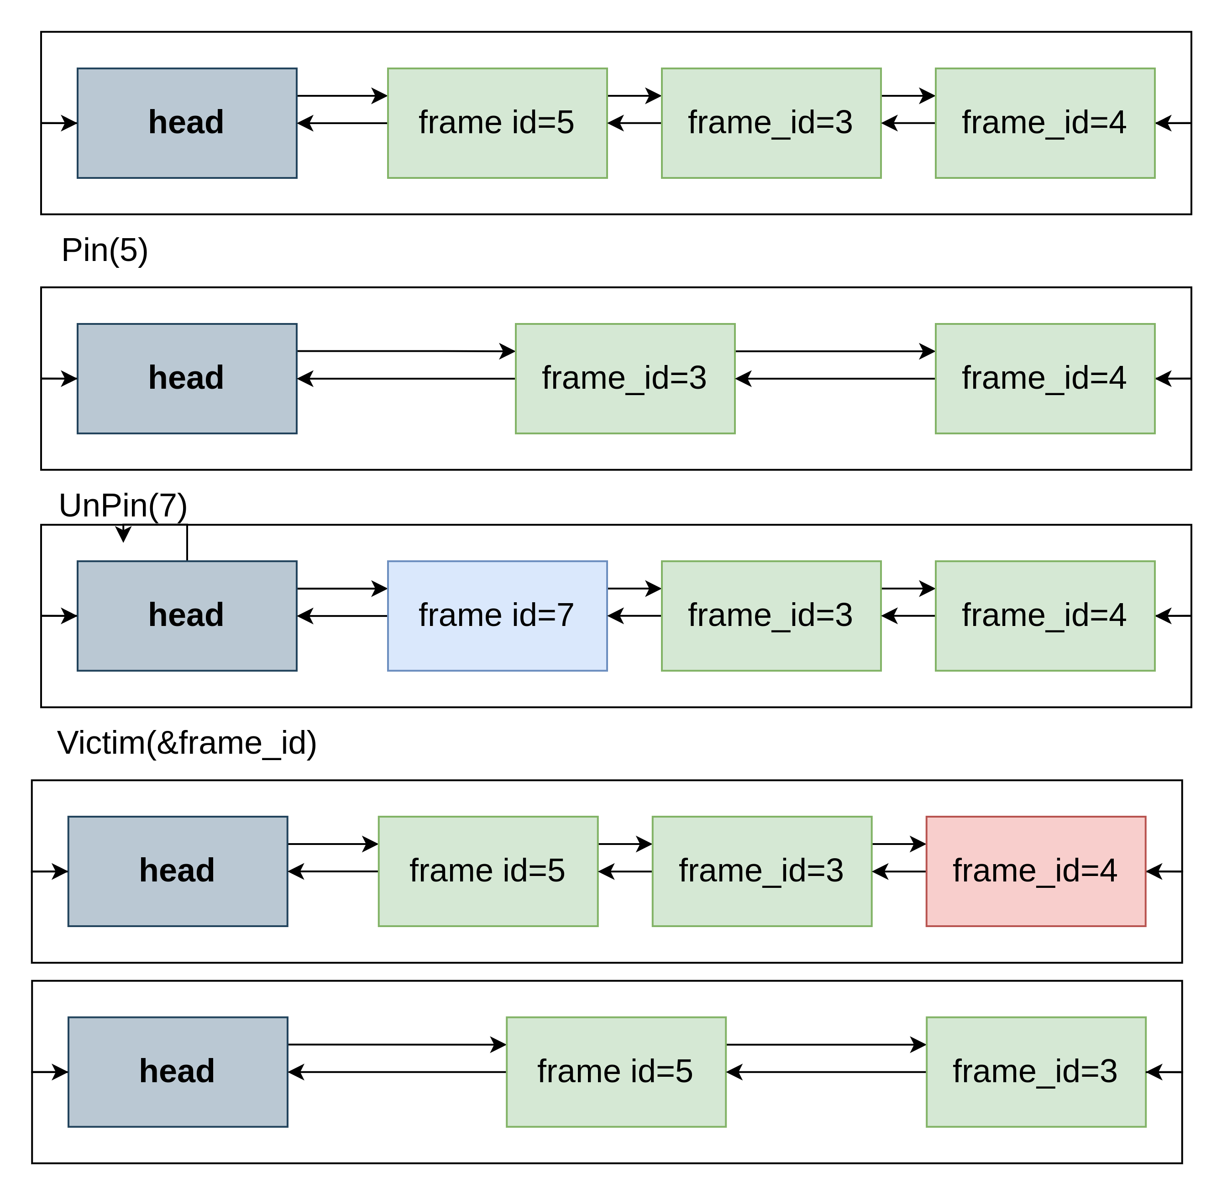
1-1.LRU Replacer
Pin → Add Node
Unpin → Delete Node
Victim → return tail of list, delete node
<number>

Slide 8
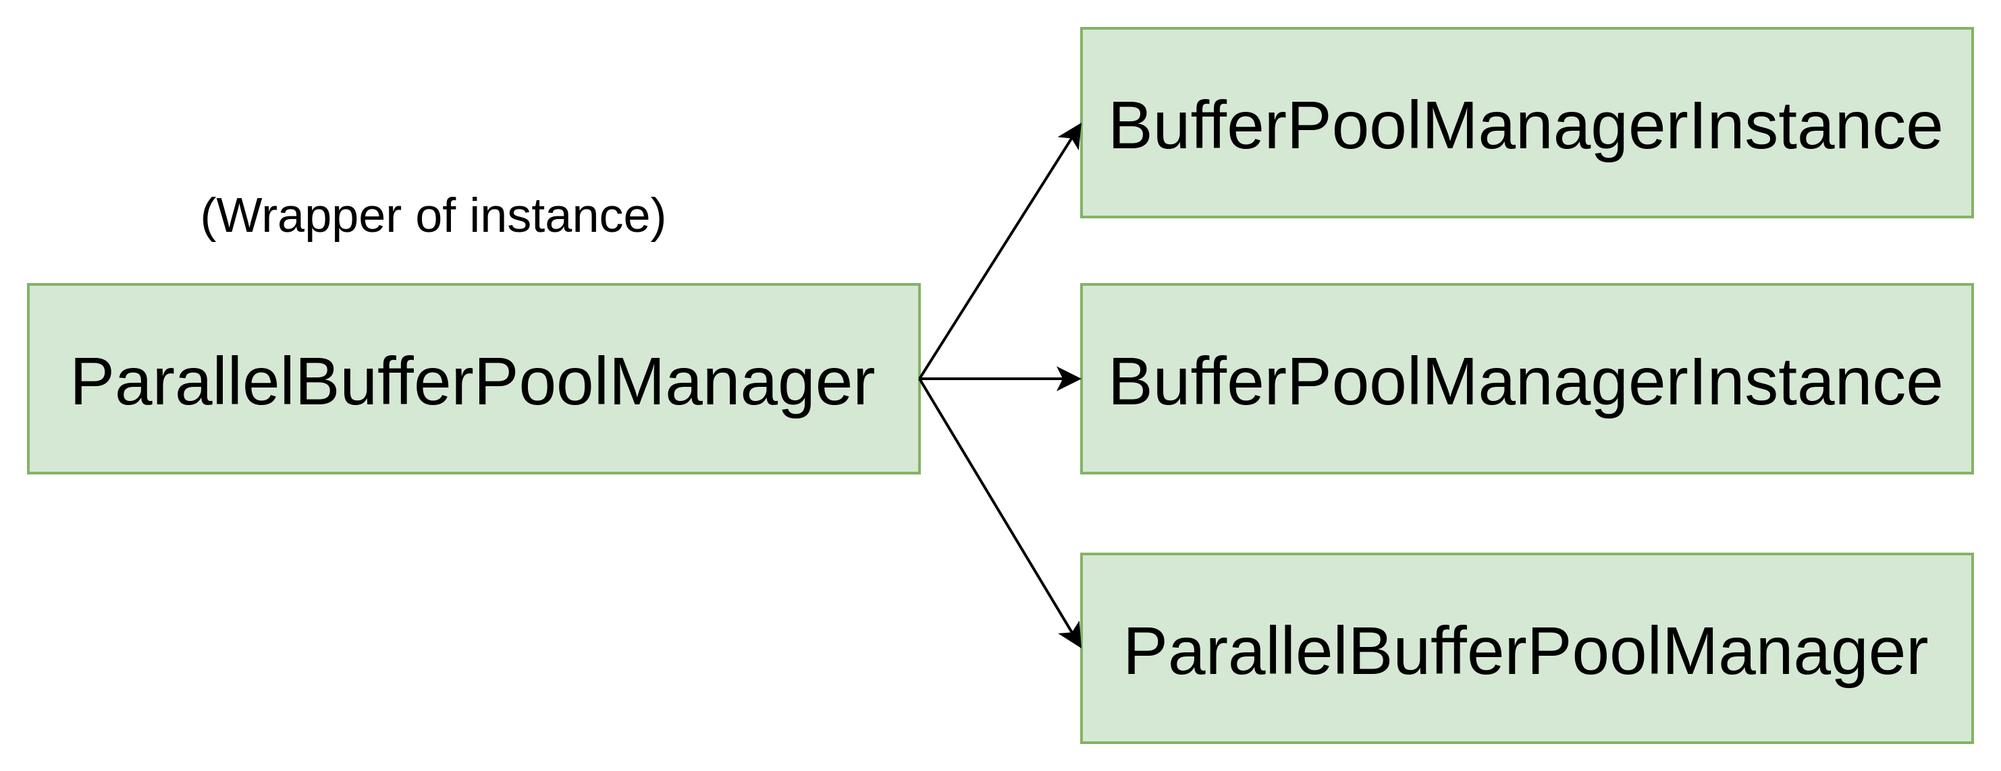
1-2.Parallel Buffer Pool Manager
num_instance=4
0,4,8,12 .. → Instance 1
1,5,9,13 .. → Instance 2
2,6,10,14 .. → Instance 3
3,7,11,15 .. → Instance 4
<number>

Slide 9
2.Extendible Hash Table
DataStructure for “INDEX” ( like B+ Tree)
Used at Query Execution (project 3)
Hash Bucket Page
Hash Directory Page
Extendible Hash Table (Manage both above)
<number>

Slide 10
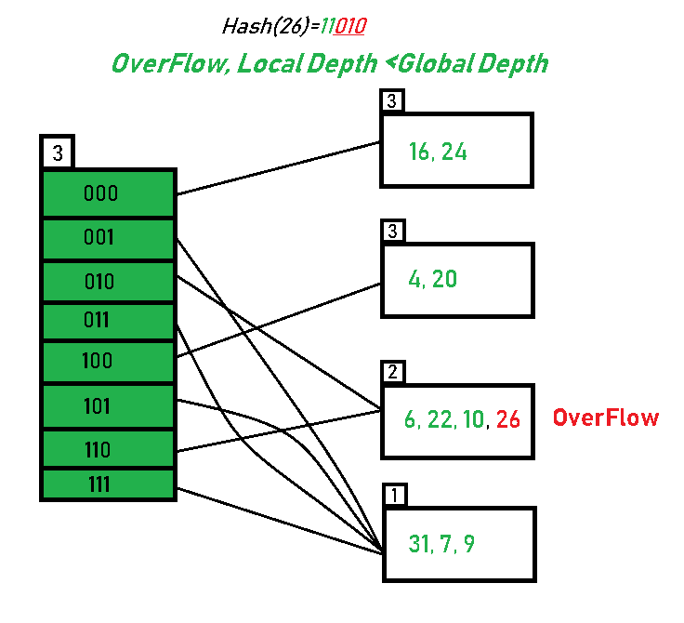
2.Extendible Hash Table
std::unordred_map
<number>

Slide 11
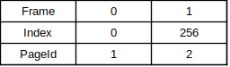
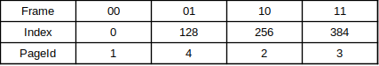
2.Extendible Hash Table
Global Depth : 1
Global Depth : 2
Global Depth : 3
<number>

Slide 12
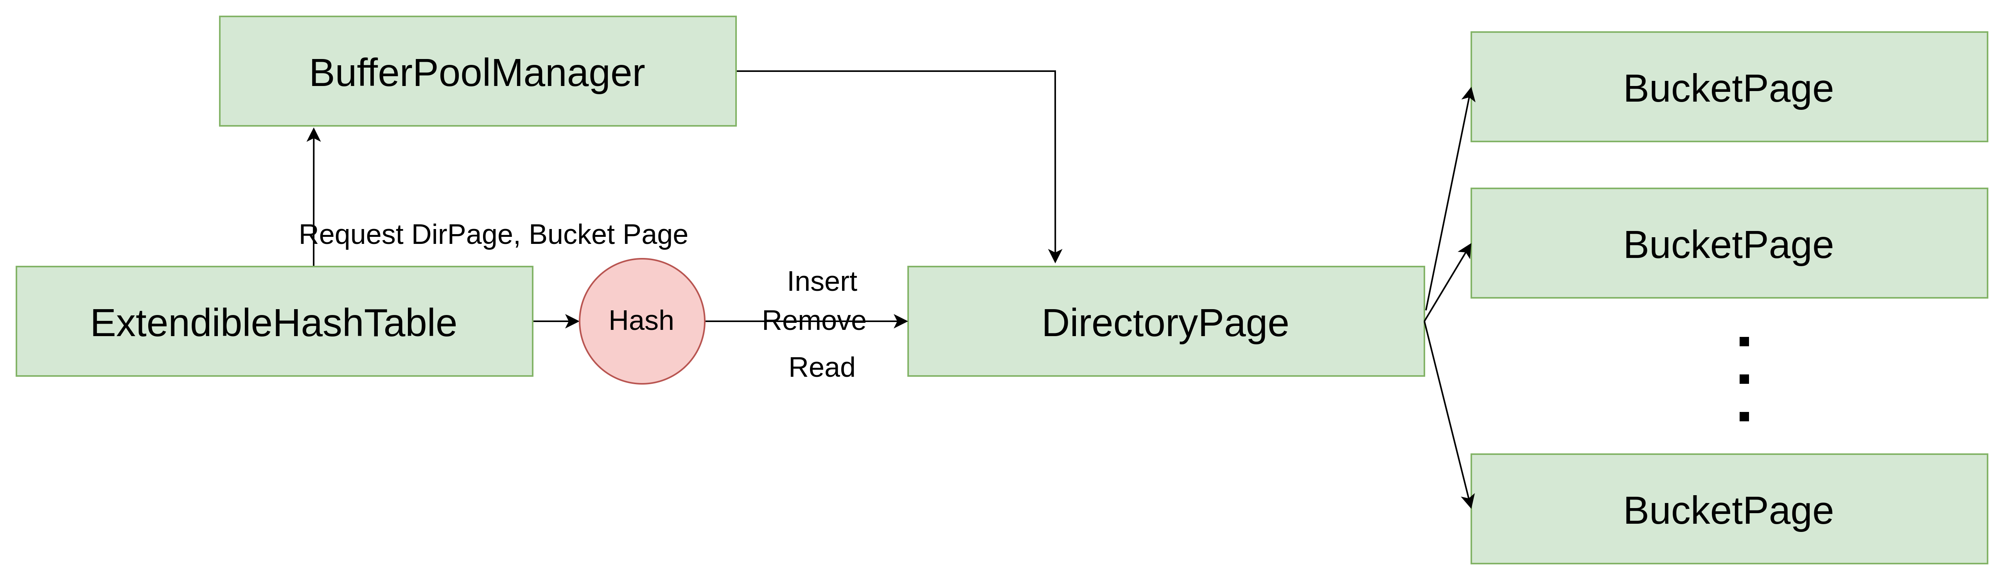
2.Extendible Hash Table
<number>

Slide 13
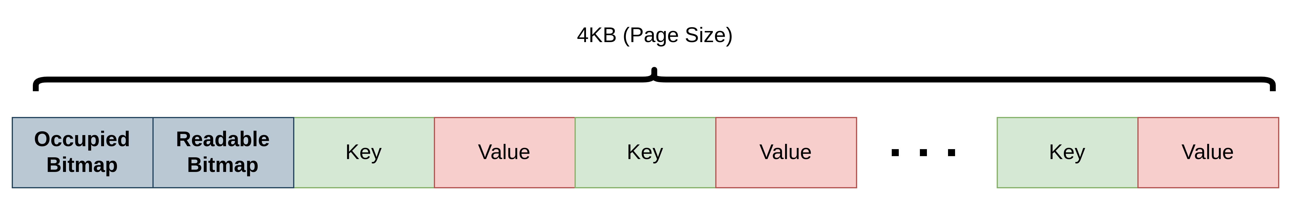
2-1.Hash Bucket Page
Bitmap calculating
<number>

Slide 14
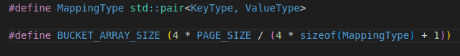
2-1.Hash Bucket Page
4 * 4096 / (4 * sizeof(Key and Value) + 1) =
4096/(sizeof(Key and Value) +0.25)
0.25 byte = 8/4 bit = 2bit ( one for readable, one for occupied)
<number>

Slide 15
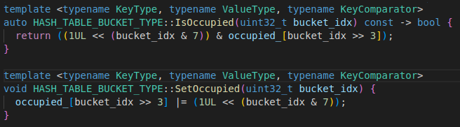
2-1.Hash Bucket Page
Bitmap calculation
Linux kernel ( buddy system )
<number>

Slide 16
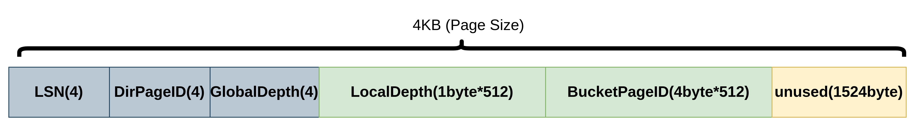
2-2.Hash Directory Page
Last Recently Used
Double Linked List
PinPage ( delete from LRU list)
UnPinPage ( add to LRU list)
<number>

Slide 17
2-3.Extendible Hash Table
std::unordred_map
<number>

Slide 18
3.Query Execution
Query Optimazation
class Expression
class Schema
class QueryPlanNode
class QueryExecutor
<number>

Slide 19
3-1. Seqeuntial Scan(SELECT)
Task 0 : Understand relation between classes (TableSchema,OutputSchema,Node,ChildNode, Executor, TableInfo, TableHeap, Column, Tuple,RID ...)
Task 1 : Understanding Iterator
Task 2 : Predicate (e.g. SELECT * FROM table where colA>10)
<number>

Slide 20
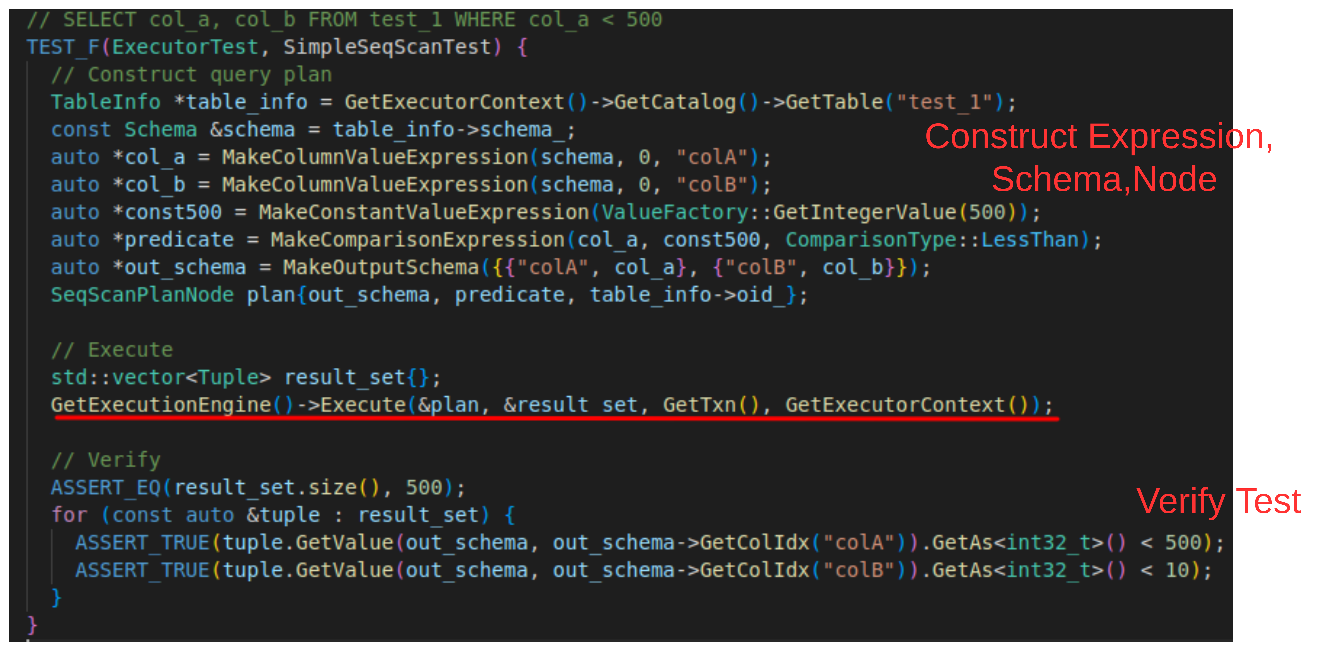
3-1. Seqeuntial Scan(SELECT)
<number>

Slide 21
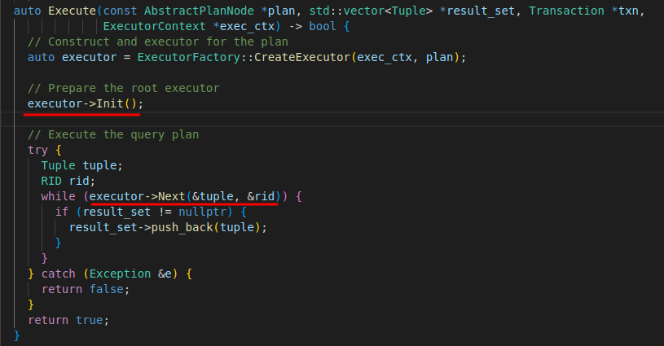
3-1. Seqeuntial Scan(SELECT)
<number>

Slide 22
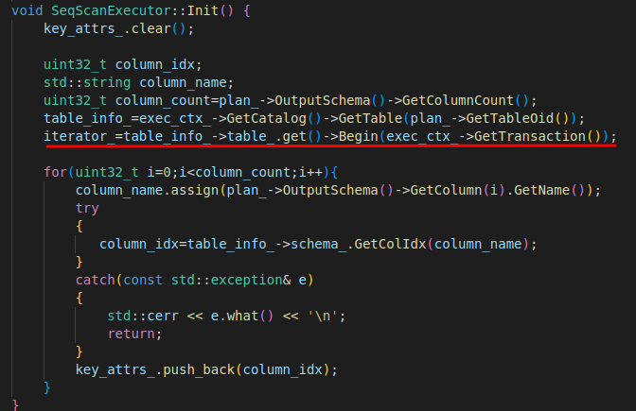
3-1. Seqeuntial Scan(SELECT)
Get ITERATOR from Table heap
<number>

Slide 23
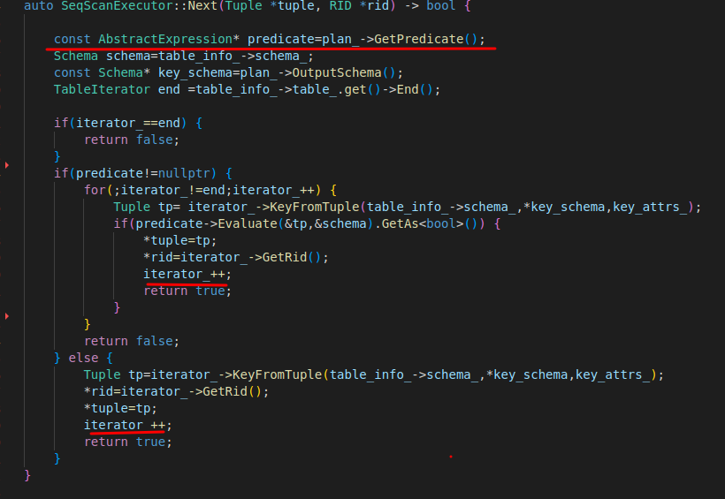
3-1. Seqeuntial Scan(SELECT)
Check Predicate, iterator++
<number>

Slide 24
3-2. INSERT
Task 1 : RAW INSERT and INSERT INTO (INNER QUERY)
Task 2 : insert INDEX
<number>

Slide 25
3-3. UPDATE
Task 1 : Child Execution
Task 2 : Update TableHeap
Task 3 : Delete index, Insert Index
<number>

Slide 26
3-4. DELETE
Query Optimazation
Schema
Query Plan Node
Query Executor
<number>

Slide 27
3-5. JOIN
SELECT table1.colA, table1.colB, table2.col1, table2.col2 FROM table1 join table2 ON table1.colA=tabe2.col1
Naive(STUPID) NESTED LOOP JOIN
Hash JOIN
Performance Metric : DISK I/O
DISK I/O granularity : PAGE (4KB)
<number>

Slide 28
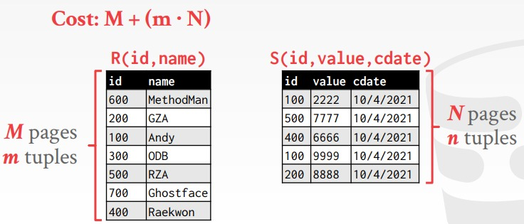
3-5-1. STUPID NESTED LOOP JOIN
<number>

Slide 29
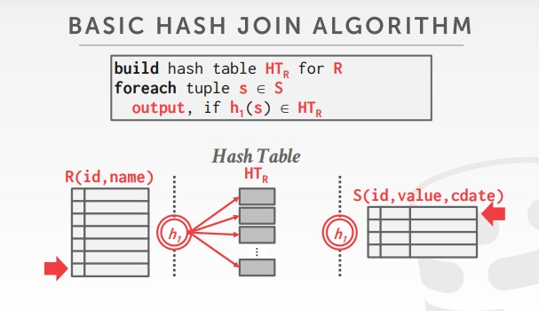
3-5-2. HASH JOIN
Build Phase
<number>

Slide 30
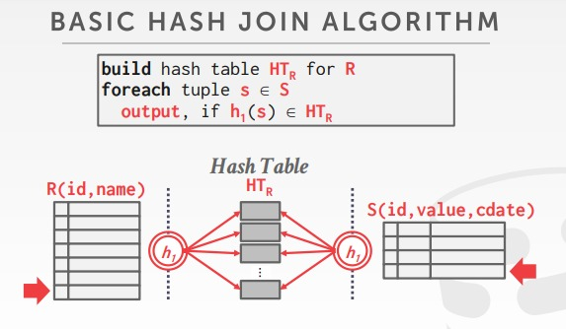
3-5-2. HASH JOIN
Probe Phase
<number>

Slide 31
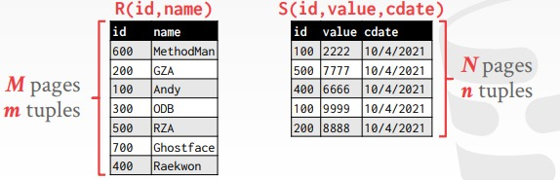
3-5-2. HASH JOIN
COST=(Left Table Hashing Cost) + N
<number>

Slide 32
3-6. Aggregation
TASK 1 : sum,count, min, max
TASK 2 : GROUP BY, HAVING
<number>

Slide 33
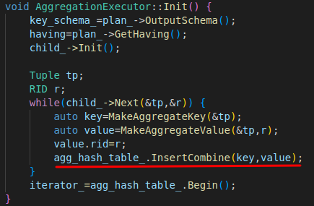
3-6. Aggregation
<number>

Slide 34
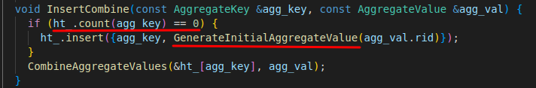
3-6. Aggregation
<number>

Slide 35
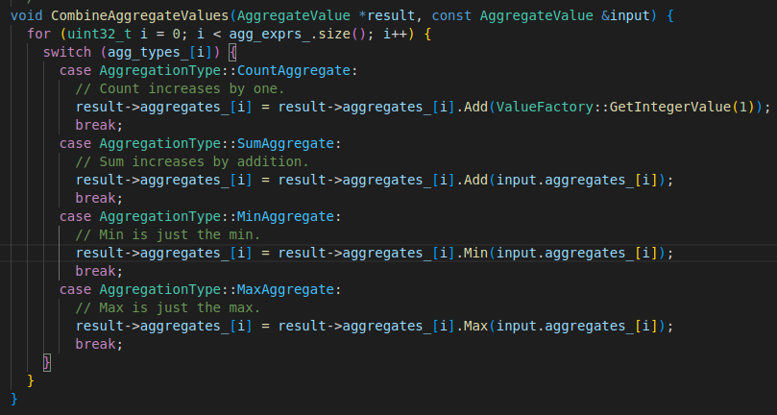
3-6. Aggregation
<number>

Slide 36
3-7. LIMIT N
TASK : Sequential Scan until reaching to N
<number>

Slide 37
3-8. DISTINCT colA
TASK : Separate already seen Value and uncatched value
<number>

Slide 38
4.Lock & Transaction
TASK 1 : 2 Phase Lock
TASK 2 : DeadLock Prevention : Wound-Wait
TASK 3 : Handling Isolation Level
<number>

Slide 39
Transaction ?
Granularity of queries executing
Prevent inconsistent state of DB
Atomicity : All or Nothing
Serializable
<number>

Slide 40
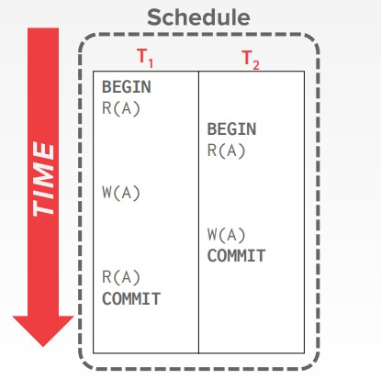
Transaction ?
<number>

Slide 41
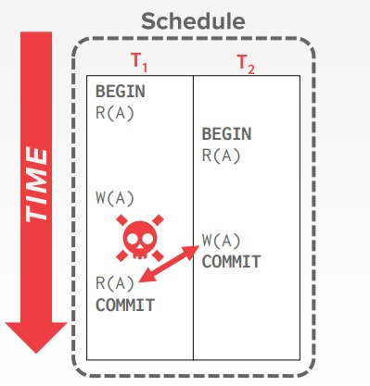
Transaction ?
<number>

Slide 42
Serializibility and Concurrency
Use Lock !
Shared Lock, Exclusive Lock
2 Phase Locking Protocol (2PL)
<number>

Slide 43
4-1. 2 Phase Lock
Serializability
Grow/Shrink Phase
<number>

Slide 44
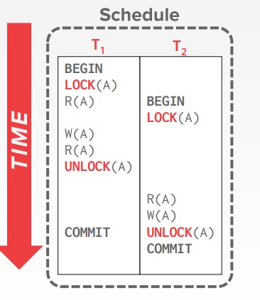
4-1. 2 Phase Lock
<number>

Slide 45
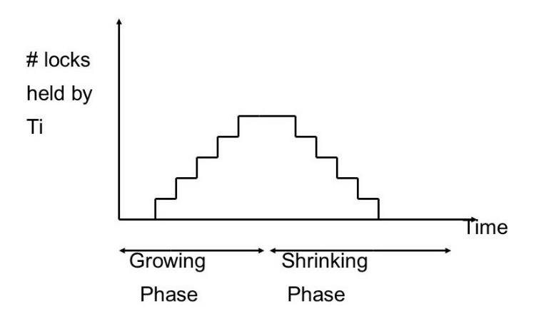
4-1. 2 Phase Lock
<number>

Slide 46
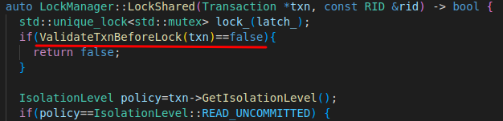
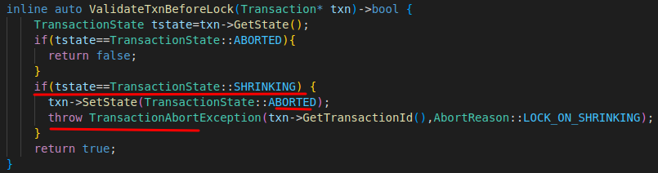
4-1. 2 Phase Lock
<number>

Slide 47
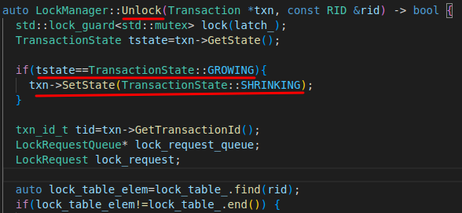
4-1. 2 Phase Lock
<number>

Slide 48
4-1. 2 Phase Lock
Good to achieve concurrency and serializabilty
Probability of DeadLock
<number>

Slide 49
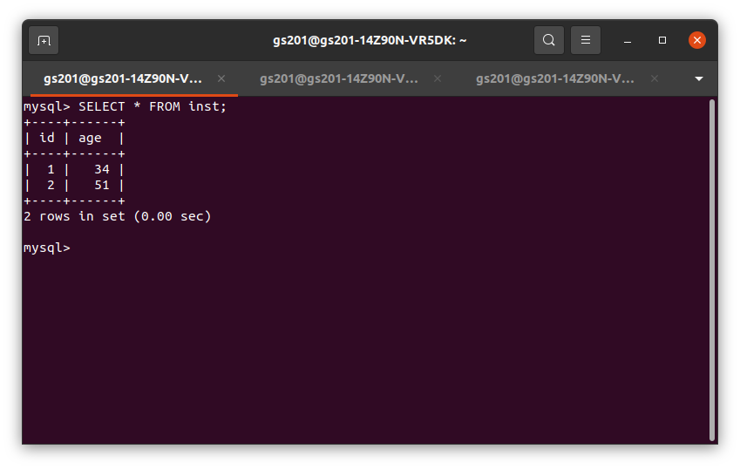
DeadLock in MySQL
<number>

Slide 50
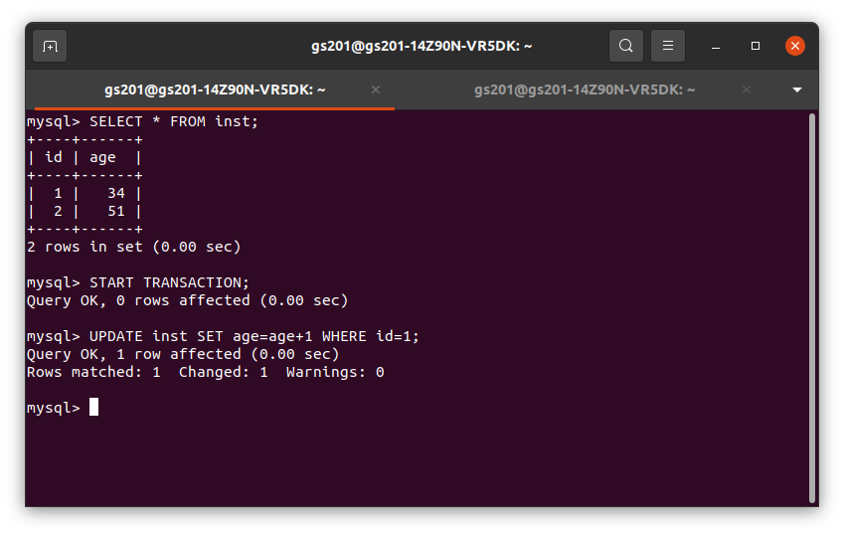
DeadLock in MySQL
Txn 1
X-Lock on
id=1
<number>

Slide 51
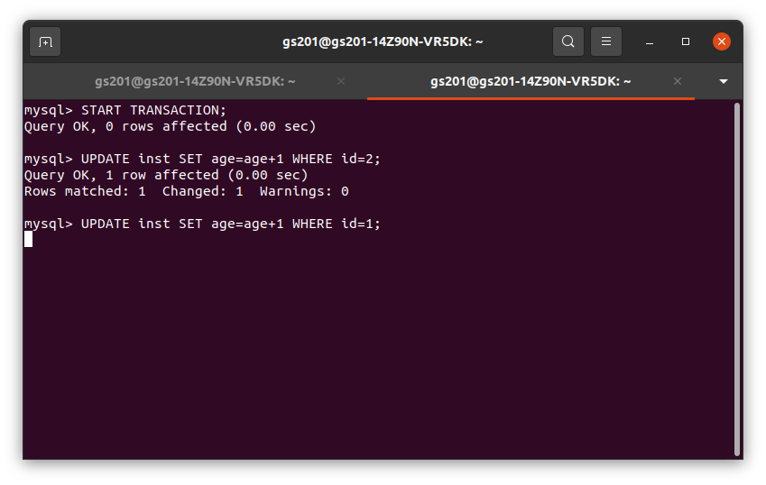
DeadLock in MySQL
Txn 2
X-Lock on
id=2,
wait For
X-Lock on
id=1
<number>

Slide 52
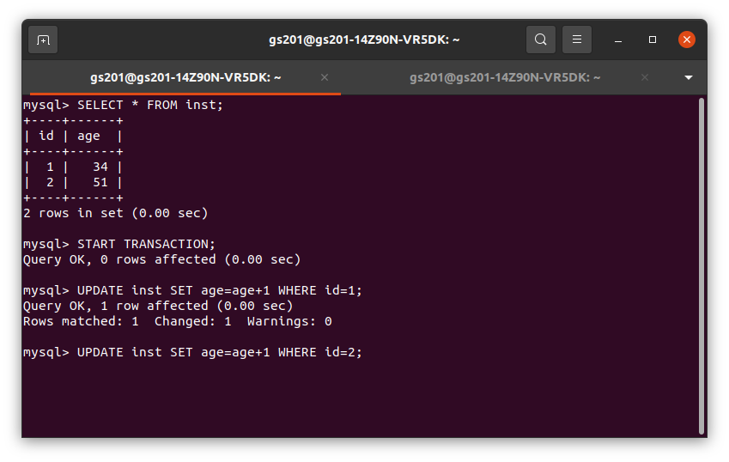
DeadLock in MySQL
Txn 1
X-Lock on
id=1,
wait for
X-Lock on
id=2
<number>

Slide 53
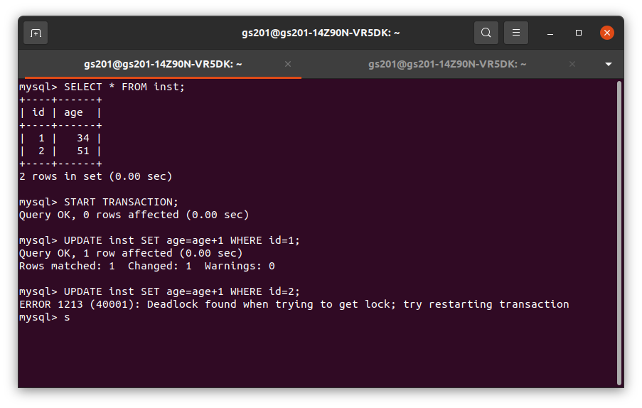
DeadLock in MySQL
Txn 1
X-Lock on
id=1,
wait for
X-Lock on
id=2
DeadLock !
<number>

Slide 54
4-2. DeadLock Prevention
DeadLock
Wound-wait
Wait-die
<number>

Slide 55
DeadLock in MySQL
Wound-wait
Wait-die
<number>

Slide 56
4-3. Isolation level
Serializable
Repeatable read
Read Committed
Read Uncommitted
<number>

Slide 57
Phantom Read
Txn1 can see the tuple or new value not touched by Txn1
<number>

Slide 58
Unrepeatable Read
Txn1 read different values from same tuple by time
<number>

Slide 59
Dirty Read
Txn1 can see data that is modified by uncommitted Txn2
<number>

Slide 60
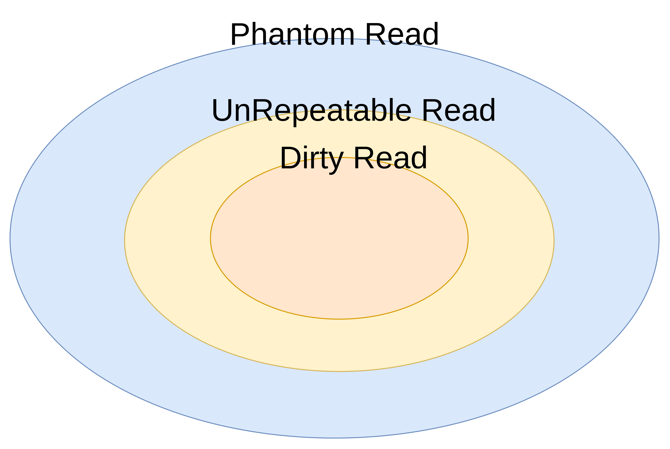
Summary
<number>

Slide 61
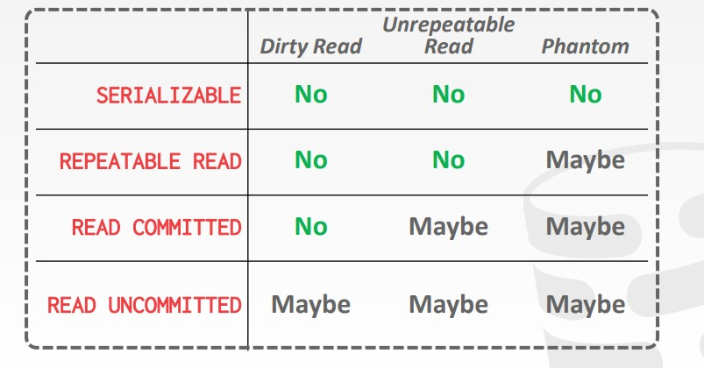
4-3 Isolation Level
<number>

Slide 62
C++ Skills
unique_lock, shared_lock, lock guard
unordered_map, unordered set ( hash table )
Allocator ( impl of vector, data structure)
list_entry,container_of ( linux kernel macro)
template<typename>
Operator Overloading
<number>

Slide 63
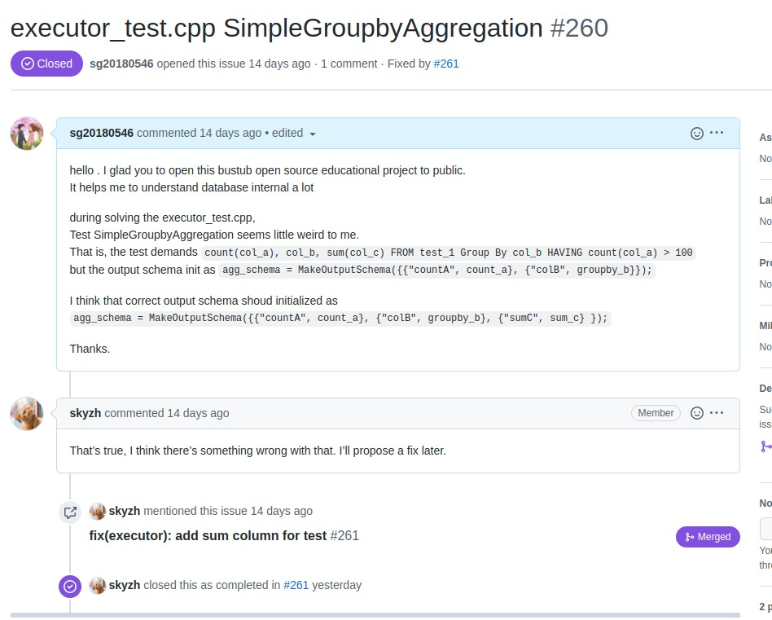
Not Perfect …
<number>

